Slide 1
Development of a measurement system for determining tongue movements and gestures based on infrared distance sensing technology.
Faculty of Electrical and Computer Engineering
INSTITUTE OF ACOUSTICS AND SPEECH COMMUNICATION
JUNIOR PROFESSORSHIP IN COGNITIVE SYSTEMS
Studienarbeit
Hamza Ben Hassen
Supervisor: M.Sc. Christoph Wagner
Reviewing Professor : Jun.-Prof. Dr.-Ing. Peter Birkholz

Slide 2
Contents
Task Description
Motivation
Solution approach
Discussion
Potential usages
Demo

Slide 3
Task Description
Make and evaluate a prototypical implementation of a tongue computer interface using infrared red proximity sensors to detect mouvement and perform gesture based actions.

Slide 4
Motivation
Hands are the main computer input modality.
Injuries or aging related illnesses resulting in loss of dexterity or disabilities are common.
Tongue control is rarely lost and shows a great flexibility and fatigue resistance.
Using tongue gestures can provide an alternative input modality for affected people.

Slide 5
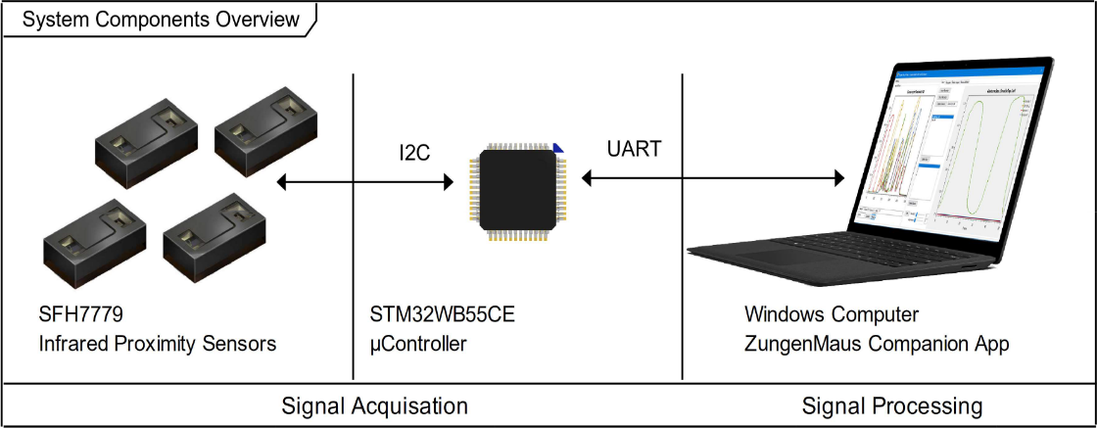
Solution approach
A signal aquisation unit composed of 4 infrared proximity sensors detect tongue position relative to the sensors.
The microcontroller collects data and builds measurement frames.
The software collects measurement frames in a circular frame buffer and implements tongue based navigation scenarios.

Slide 6
Hardware

Slide 7
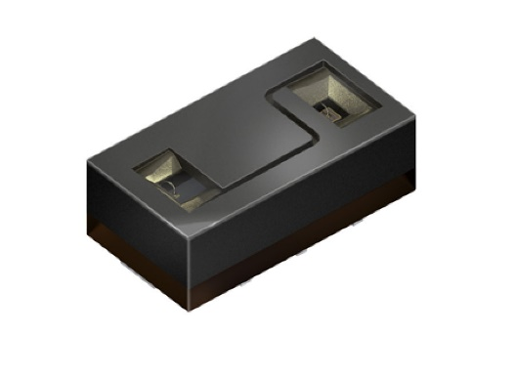
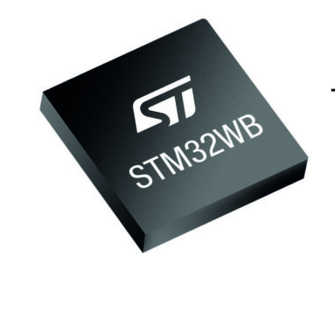
Hardware Components
Sensors : Osram SFH 7779
-Miniature package 4mm x 2.1mm x 1.35mm.
-Detection range up to 160 mm
-940 nm IR emitter
Microcontroller : STM32WB55
- Arm® Cortex®‐M4 core @64 MHz
-Small form factor : 7mm x 7mm x 0.55 mm
-Ultra low power consumption
-Integrated Bluetooth Stack

Slide 8
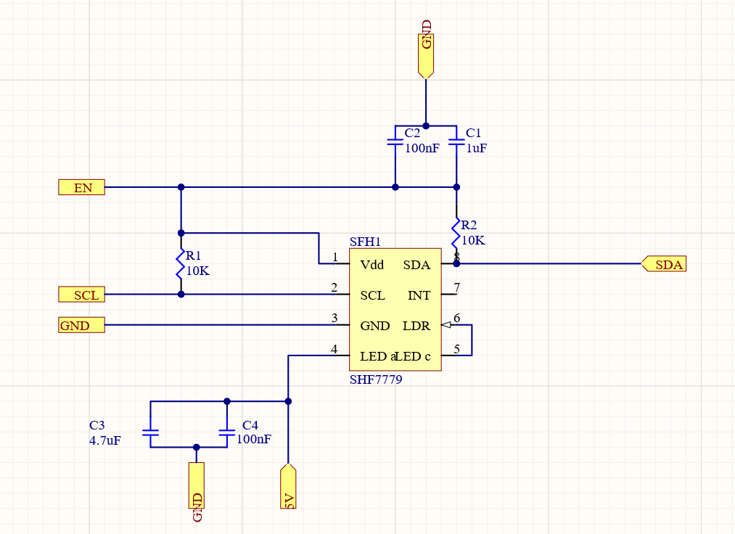
Sensor wiring
I2C interface using a clock signal SCL and a data Line SDL Requiring pullup resistors R1,R2 and filtering capacitance C2 and C1.
5V input for the IR Led.
Vdd is treated as an enable signal.

Slide 9
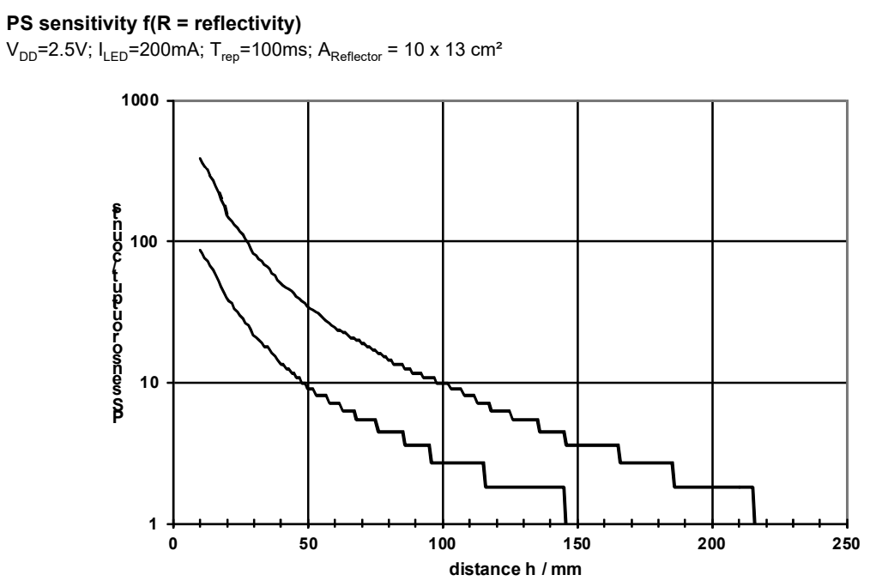
Sensor wiring
Data is provided @420 Hz in Counts as shown in the sensitivity Diagram.

Slide 10
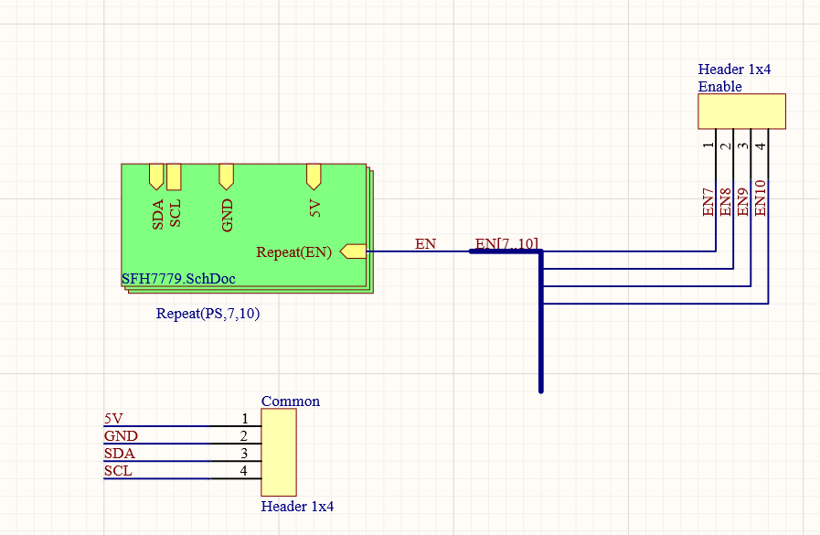
Multiplexing
All sensors share a fixed I2C address.
Multiplexing is required to interface all sensors using limited i2C interfaces.
Temporal multiplexing does not require additional hardware, but results in a slower scan rate.
Enable signals ( VDD input ) are wired to different GPIOs of the Microcontroller.

Slide 11
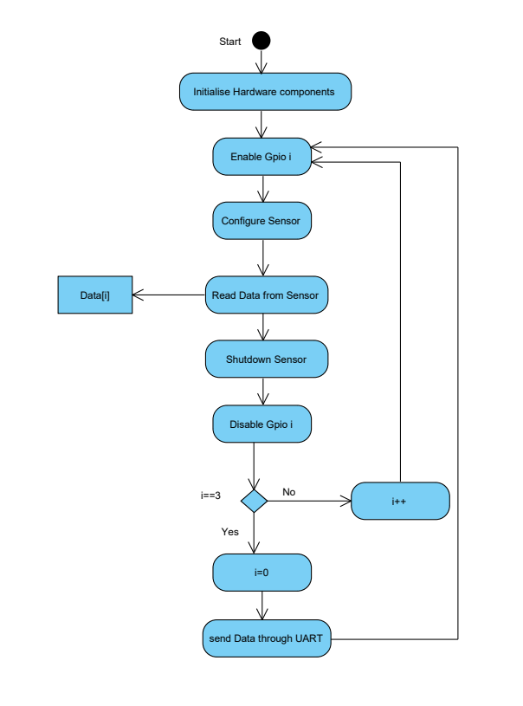
Multiplexing
The microcontroller sequentially polls each sensor.
A measurement frame is sent to the computer once all sensors were polled.
A measurement frame has this formatting : xxx;xxx;xxx;xxx/r /n

Slide 12
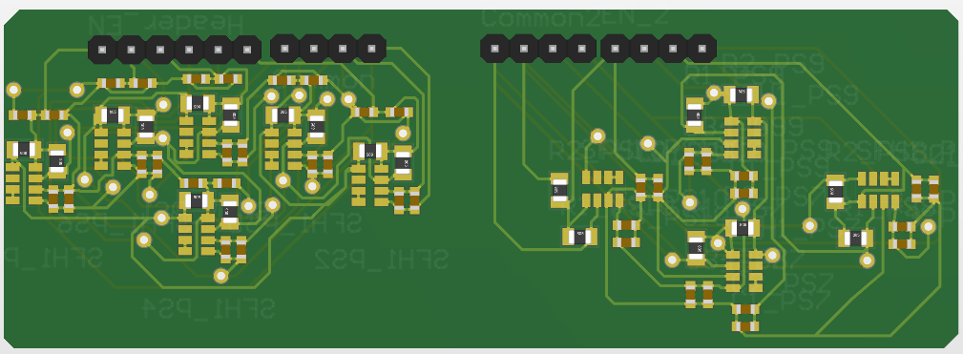
PCB design
6 and 4 sensor versions.
All sensors share a single I2C connection.
Each sensor has an individual enable signal.
Only 1 sensor could be adressed using the 4 sensor version : Pullup resistances were not correctly adjusted.
Y-Flipped sensor pads made the 6 sensors version unusable.

Slide 13
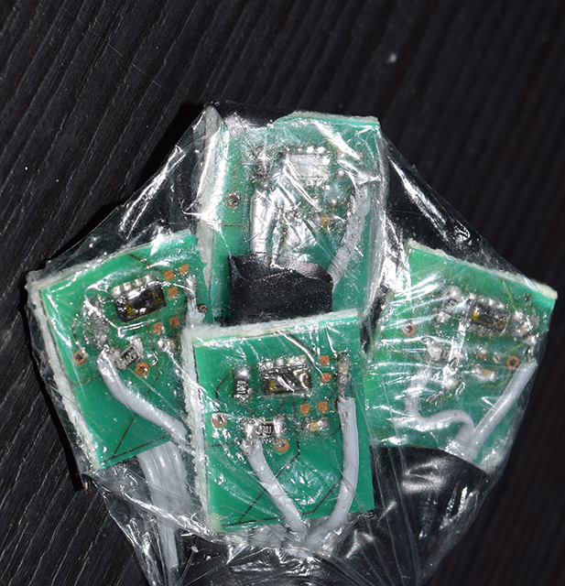
Workaround
-4 Infrared Proximity sensors modules are made using the PCB.
-Modules are grouped in pairs , each sharing an SDA and SCL lines.

Slide 14
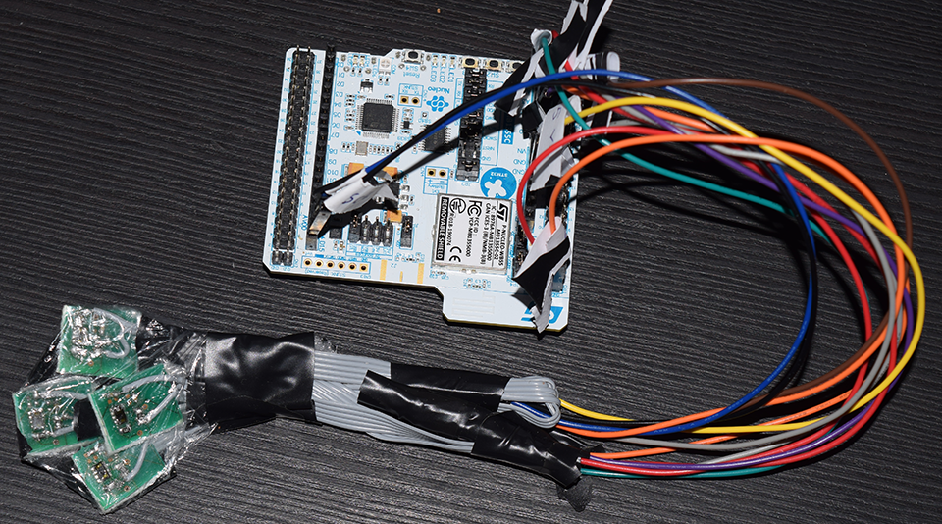
Evaluation Prototype
Nucleo WB development board.
COM over USB Connection to PC.
Scanrates measured in software:
Number of I2c interfaces | Number of Sensors | Scanrate
1 | 1 | 420 Hz
2 | 2 | 420 Hz
2 | 4 | 84 Hz

Slide 15
Used Tools
STM32CubeIDE : to program the microcontroller.
Altium Designer: to design the PCB.

Slide 16
Software

Slide 17
Framework and used libraries
Development IDE : Visual Studio 2019
Language : C#
Framework: .Net framework 4
Libraries :
OxyPlot is a cross-platform plotting library for .NET
Json.NET is a Popular high-performance JSON framework for .NET
NDtw is Dynamic Time Warping (DTW) algorithm implementation for .NET C#

Slide 18
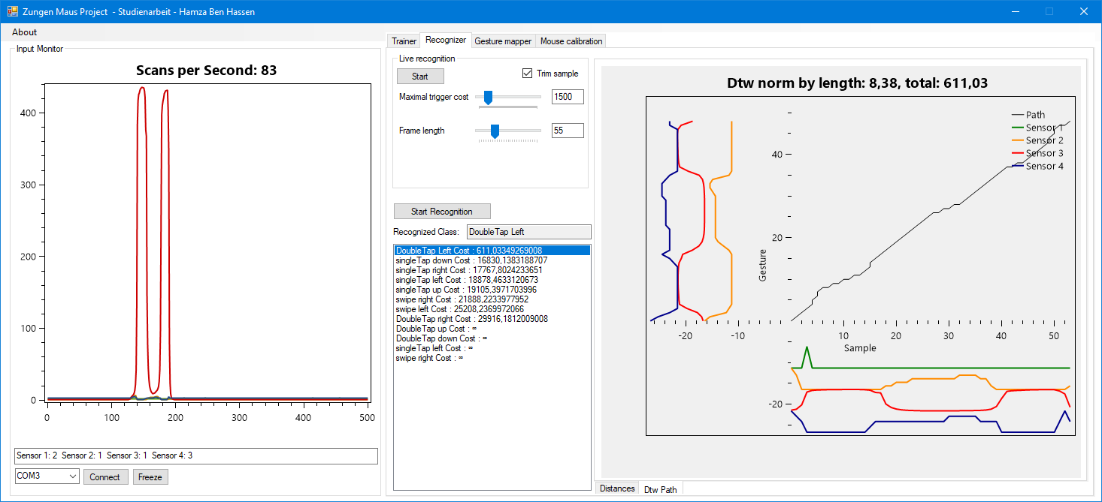
Features and userinterface
Visualise Measurment frames from a COM port.
Train new gestures and map them to various actions.
Single and continuous gesture recognition.
Basic 4-axe mouse controller.

Slide 19
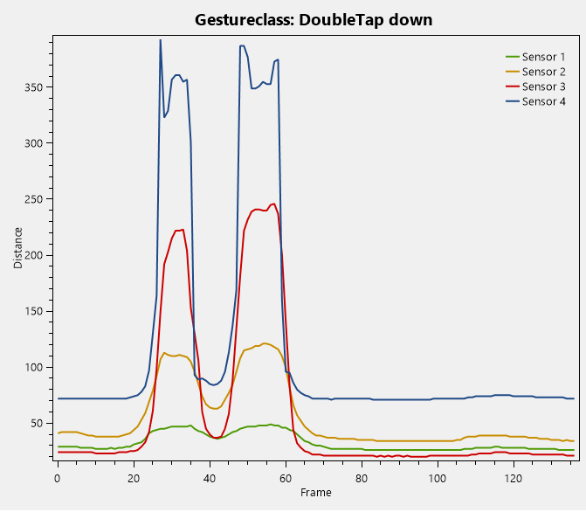
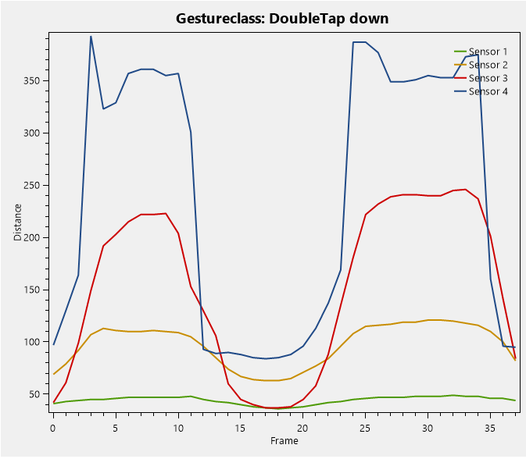
Gesture Recognition
Align input sequence and gesture sequence by trimming idle state.
Calculate similarity between sequences using Dynamic Time Warping to Account for temporal variation.

Slide 20
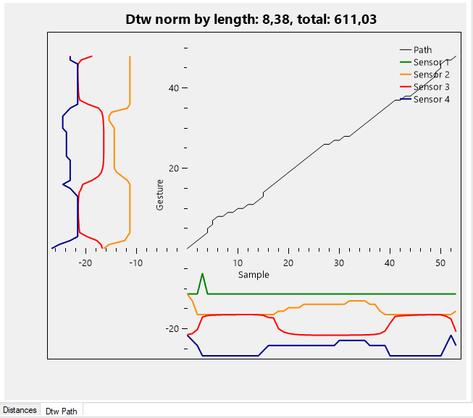
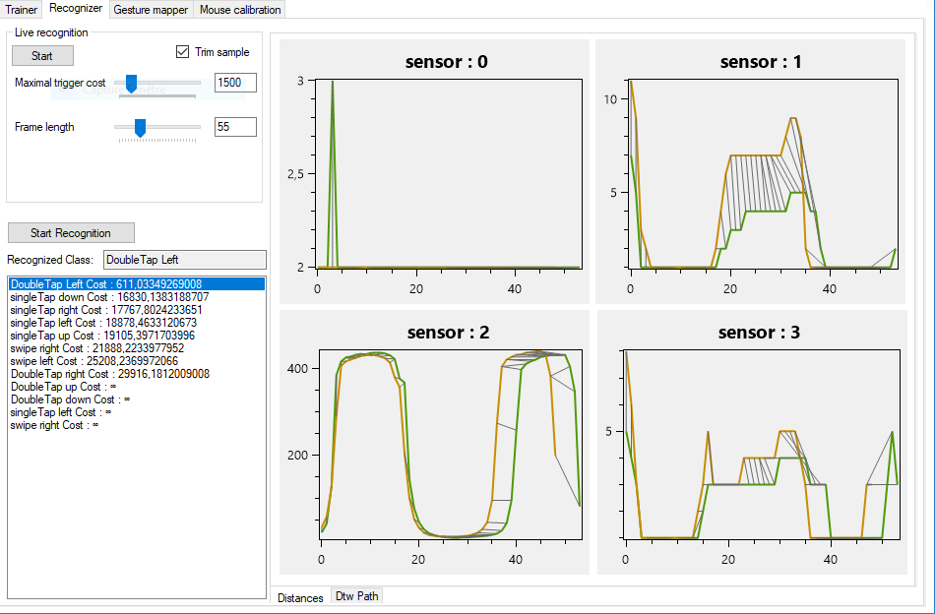
Gesture Recognition
A visualization of the recognition allows to adjust recognizer parameters, or delete bad samples.

Slide 21
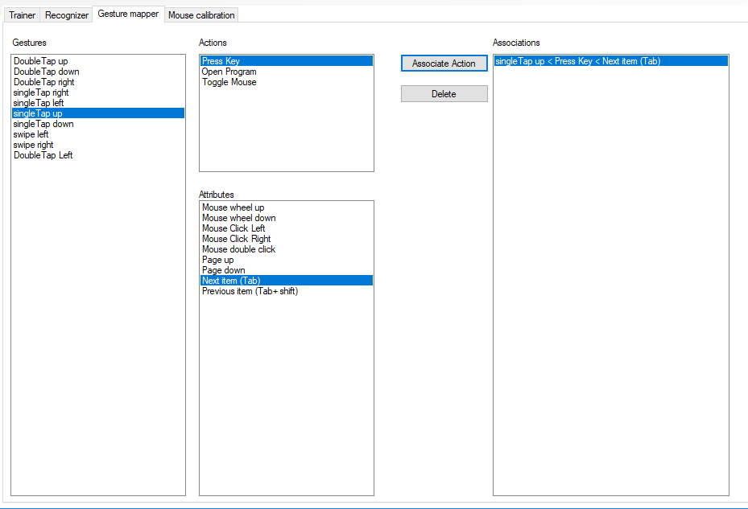
Gesture Mapper
Mouse and Keyboard events can be simulated using the Windows User
[DllImport("user32.dll")] .
Windows USER is a component of the Microsoft Windows operating system that provides core functionality for building simple user interfaces. The component has existed in all versions of Windows, and includes functionality for window management, message passing, input processing and standard controls.

Slide 22
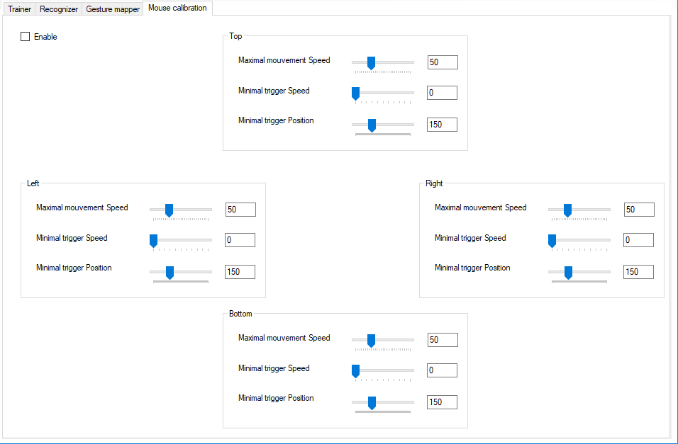
Mouse Controlling
The implemented concept treats the aquisation unit as an analog joystic.
Moving the tongue towards a sensor moves the cursor in the sensor direction.
To account for multiple sensors being activated in the same time , minimal activation thresholds can be finetuned.

Slide 23
Discussion

Slide 24
Discussion
This implementation of temporal multiplexing is not adequate for more than 4 sensors, an external I2C Multiplexer can provide faster scanrates.
Associating an individual trigger cost for each gesture can result in a more accurate recognition.
Gesture samples can be grouped in represantative statistical models. This can improve the speed and precision of the recognition.
Different mouse controlling algorithms should be explored to provide a customizable experience.
The software can be used to investigate further accessibilty scenarios using various sensing technologies.
A lot of time was spent experimenting with Bluetooth functionalities of the SoC, this could have been better dedicated for more urgent documentation tasks.

Slide 25
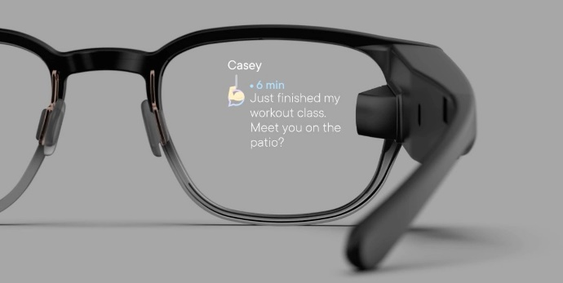
Potential usages
Gaze tracking has been reliably used to point at the screen. However performing actions using the eyes interferes with user vision.
A tongue mouse can be used for interactions with the user current area of interest detected by a gaze tracker. This can provide an alternative computer input method that might be faster than traditional mouse input and can have usages beyond assistive devices.
A tongue mouse can be combined with a smart glass and can provide a discrete interaction with external world or other smart devices.
The current implementation can be used as a midi device allowing keyboard players to manipulate pitch and modulation ( for example ) while playing with two hands.
https://www.bynorth.com/

Slide 26
Demo

Slide 27
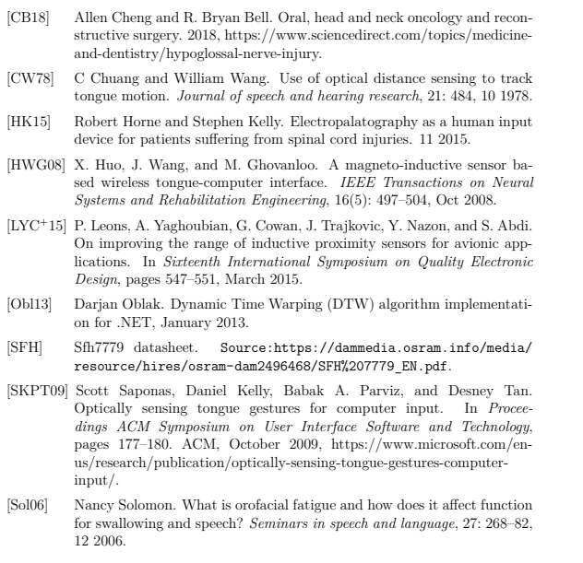
References

Slide 28
Thank you for your attention

